Slide 1

DIGITAL LOGIC DESIGN

Slide 2
Course Assessment:
Mid Exam
Quizes or Presentation Home Assignment Project
Final Exam
Reference Books:
Digital logic and Computer Design by Morris Mano
Digital Fundamentals by Floyd 11th Edition

Slide 3

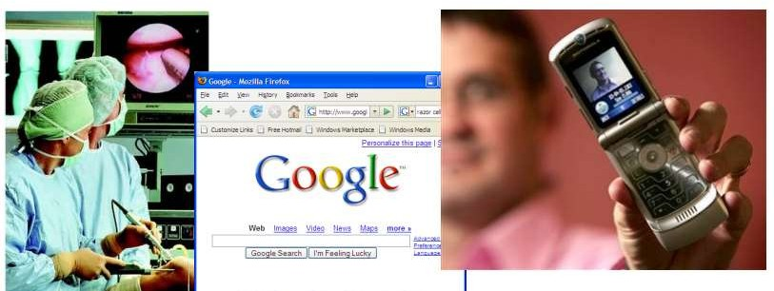
INTRODUCTION
Digital Revolution
The digital revolution definition refers to the advancement of technology from analog devices to the digital technologies available today.

Slide 4
ANALOGUE VERSUS DIGITAL
Most of the quantities in nature that can be measured are continuous. Examples include:
Intensity of light during the day: The intensity of light gradually increases as the sun rises in the morning; it remains constant throughout the day and then gradually decreases as the sun sets until it becomes completely dark.
Rise and fall in temperature during a 24-hour period: The temperature also rises and falls with the passage of time during the day and in the night. The change in temperature is never abrupt but gradual and continuous.
Velocity of a car travelling from A to B: The velocity of a car travelling from one city to another varies in a continuous manner.

Slide 5
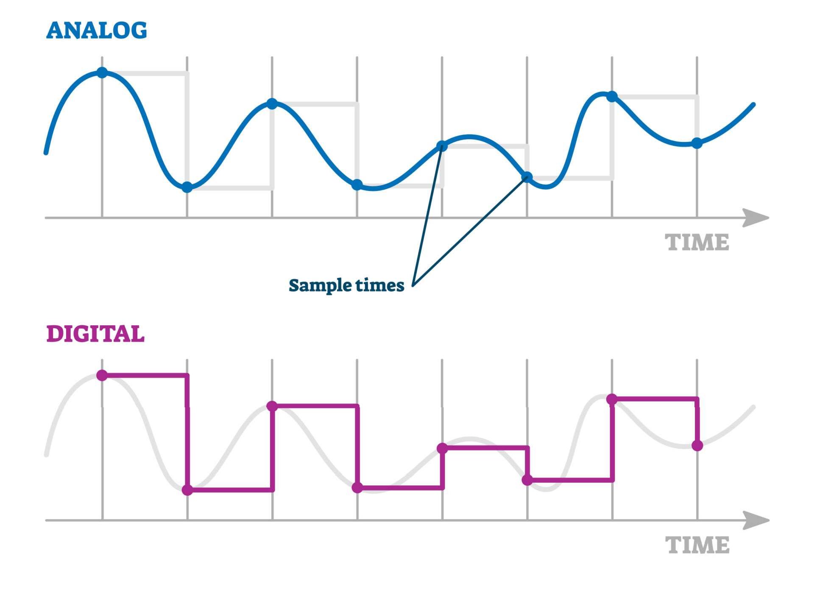
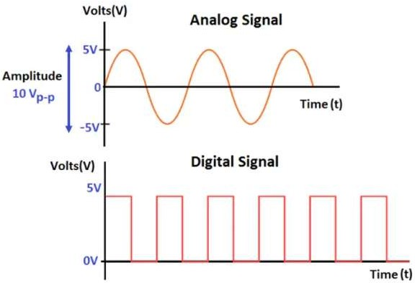
Digital quantities unlike Analogue quantities are not continuous but represent quantities measured at discrete intervals.

Slide 6
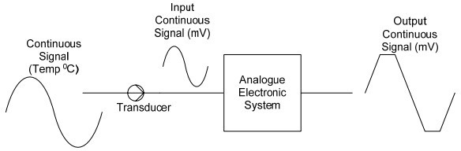
ELECTRONIC PROCESSING OF CONTINUOUS AND DIGITAL QUANTITIES
Analog
Uses Analog Signals

Slide 7
Digital
Uses Digital Signal
Digital Systems and Digital Values Digital systems are designed to work with two voltage values. A +5 volts represents a logic high state or logic 1 state and 0 volts represents a logic low state or logic 0 state. The Digital Systems which are based on two voltage values or two states can easily represent any two values. For example,
The numbers ‘0’ and ‘1’
The state of a switch ‘on’ or ‘off’ The colour ‘black’ and ‘white’ The temperature ‘hot’ and ‘cold’ An object ‘moving’ or ‘stationary

Slide 8
BENEFITS OF DIGITAL SYSTEMS
Storing and processing data in the digital domain is more efficient: Computers are very efficient in processing massive amounts of information and data.
Transmission of data in the digital form is more efficient and reliable: Modern information
transmission techniques are relying more on digital transmission due to its reliability as it is less prone to errors.
Detecting and Correcting errors in digital data is easier: Coding Theory is an area which deals with
implementing digital codes that allow for detection and correction of multi bit errors. In the Digital Logic Design course a simple method to detect single bit errors using the Parity bit will be considered.
Data can be easily and precisely reproduced: The picture quality and the sound quality of digital
videos are far more superior to those of analogue videos. The reason being that the digital video
stored as digital numbers can be exactly reproduced where as analogue video is stored as a continuous signal can not be reproduced with exact precision.
Digital systems are easy to design and implement: Digital Systems are based on two state Binary
Number System. Consequently the Digital Circuitry is based on the two voltage states, performing very
simple operations. Complex Microprocessors are implemented using simple digital circuits. Several simple Digital Systems will be discussed in the Digital Logic course.

Slide 9
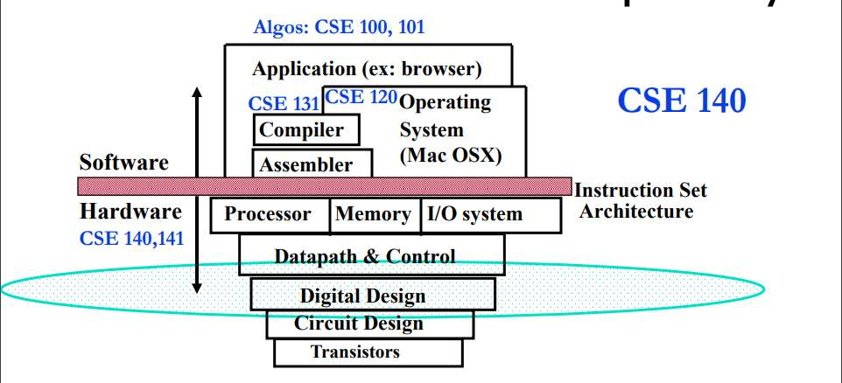
REPRESENTATION OF DIGITAL DESIGN IN SYSTEMS

Slide 10

So,
If we are representing only ‘0’ or ‘1’ and ‘ON’ or ‘OFF’
But,
Usually phenomenon around us do not occur in this way

Slide 11
A Digital System (computer) is capable of handling different types of information, which is represented in the form of Binary Numbers. The different types of information use different standards and binary formats.
For example, computers use the Binary number system to represent numbers. Characters used in writing text are represented through yet another standard known as ASCII which allows alphabets, punctuation marks and numbers to be represented through a combination of 0s and 1s.

Slide 12
NUMBER SYSTEM
Number systems are the technique to represent numbers in the computer system architecture, every value that you are saving or getting into/from computer memory has a defined number system.
Computer architecture supports following number systems.
Binary number system
Octal number system Decimal number system
Hexadecimal (hex) number system

Slide 13
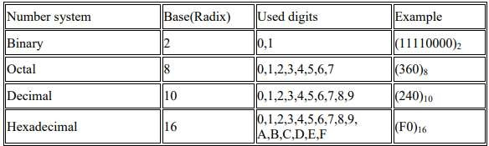

Slide 14
BINARY INTERCONVERSION
DECIMAL TO BINARY
Decimal Number System to Binary number system; you have to follow just two steps:
Divide the Number (Decimal Number) by the base of target base system (in which you want to convert the number: Binary (2), octal (8) and Hexadecimal (16)).
Write the remainder from step 1 as a Least Signification Bit (LSB) to Step last as a Most Significant Bit (MSB).

Slide 15
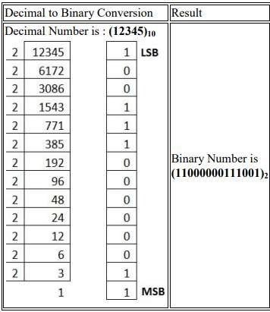

Slide 16
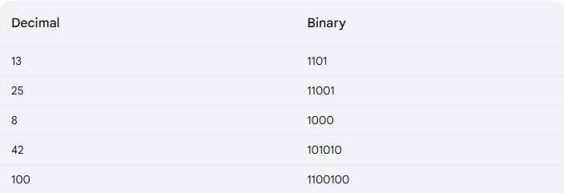
QUESTIONS

Slide 17
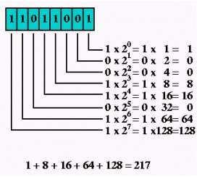
BINARY TO OTHER
Multiply the digit with 2(with place value exponent). Eventually add all the multiplication becomes the Decimal number.

Slide 18
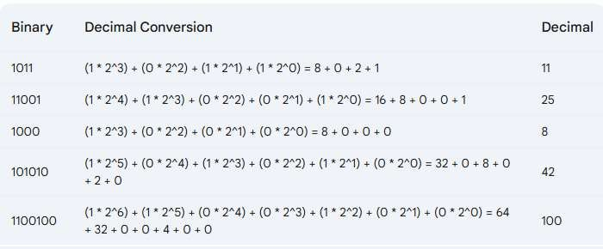
QUESTIONS

